Slide 1




Declaration of Construction Completion
and
Verification of Readiness to Test
Salt Waste Processing Facility
Project No. 05-D-405 (Savannah River Site- Aiken, SC)
Pam Marks, FPD, DOE-SR
March 2, 2016

Slide 2
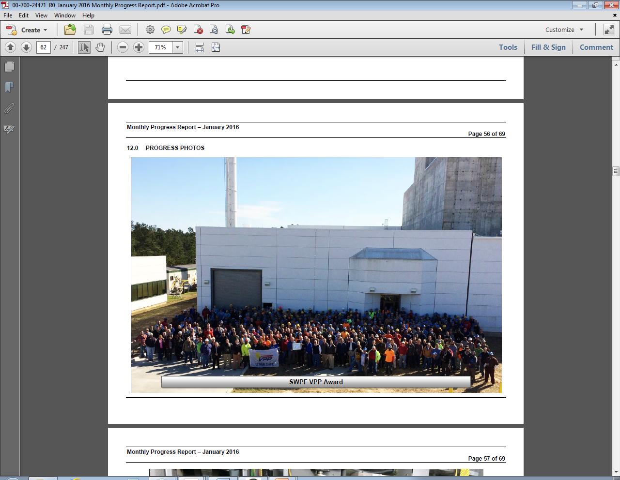
Purpose and Objective
To provide an overview of the contract requirements and processes implemented to ensure the Salt Waste Processing Facility (SWPF) has attained a state of Construction Completion
To provide assurance that DOE and the contractor have a high level of confidence that the facility components and systems, processes, people and paper are in place to commence testing

Slide 3
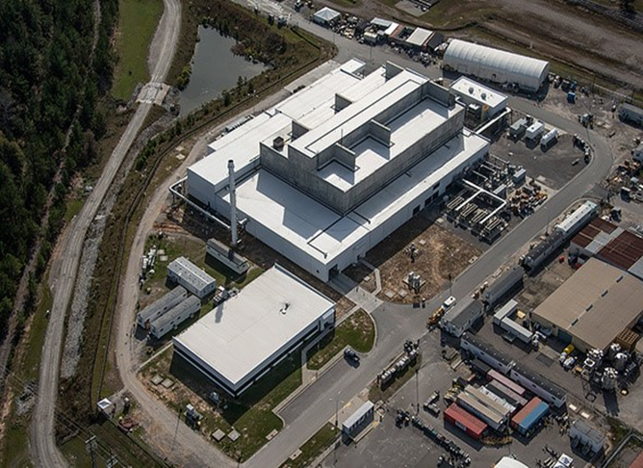
Declaration of Construction Completion – Contract Requirements
Modification 116 to contract DE-AC09-02R22210 established the criteria for Declaration and Acceptance of Construction Completion for SWPF
Completion of SWPF facility construction in accordance with the technical baseline diagrams and drawings to include:
Design Criteria Database
Basis of Design (Process and Balance of Plant)
Process Flow Diagrams
Piping and Instrumentation Drawings
General Arrangement Drawings
Electrical Single Line
HVAC Diagrams
Radiation Zone Diagrams
Material Handling Mechanical Flow Diagrams

Slide 4
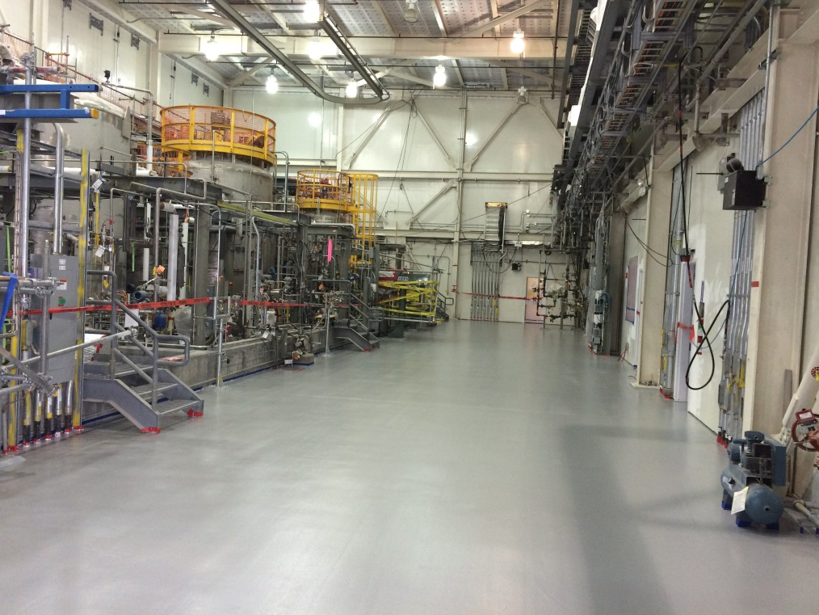
Declaration of Construction Completion – Contract Requirements (cont.)
Facilities within the scope of the Construction Completion milestone include:
Central Process Area (CPA)
Caustic-Side Solvent Extraction (CSSX)
Alpha Finishing Facility (AFF)
Cold Chemical Area (CCA)
Analytical Laboratory
Diesel Generator Area
Compressor Building
Northern and Eastern Facility Support Areas
Waste Transfer Lines to the designated tie in points
SWPF CCA Work Area – February 24, 2016

Slide 5
Declaration of Construction Completion – Contract Requirements (cont.)
Requires construction installation, checks and tests to be complete for System Operational Testing (SOT) activities to begin.
Requires Commissioning Planning to be completed (Rev. 00 SOT, Integrated System Operability Test (ISOT) and Calibration, Grooming & Alignment (CG&A) procedures)
Turnover Process governed by PP-CM-8103 “SWPF System Turnover from Construction to Commissioning and Testing Organization”
71 Systems identified in PP-CM-8103
Turnover Acceptance Forms (SWPF-436) documented for all 71 systems
10 day notification required for all initial and final system turnover walk downs
No open “A” punchlist items (“A” items = inoperable equipment required for component of system testing; items affecting safe completion of component or system testing)
Manageable list of “B” punchlist items (“B” items = minor elements of work which do not prevent the utilization of the facility, in part of in whole; items that do not impact system or component operability or safety)

Slide 6
Declaration of Construction Completion – Contract Requirements (cont.)
Final acceptance of the Construction Completion Milestone is determined by the Federal Project Director (FPD) and Contracting Officer (CO)
Contractor will declare in writing that construction has been completed per contract requirements
DOE has 5 days to determine the reasonableness of the declaration
Upon DOE acceptance that the declaration is “reasonable”, the cost incurred and completion date become fixed for purposes of fee determination.
DOE has 30 days from the determination of reasonableness to formally accept or reject the Contractor’s declaration.
In the event DOE rejects the declaration, all costs to resolve findings are not reimbursable.

Slide 7
Declaration of Construction Completion – Parsons’ Letter to DOE
Parsons’ Letter to DOE for Declaration of Construction Completion will contain:
Completed SWPF-436 Turnover Acceptance forms
List of System Turnover Package Submittals
Summary Table of Open ‘B’ Items by System, including evidence of a manageable list
Confirmation that open non-conformance reports and Construction Requests for Information have been evaluated and dispositioned to the appropriate ”A” or “B” punchlist
Confirmation Engineering Open Items have been either closed or captured on the appropriate punchlist
Confirmation CG&A procedures have been prepared, and SOT and ISOT procedures have been completed to Revision 0 fulfilling CLIN 0005AC scope of work
Listing of CG&A procedures
Listing of Revision 0 SOT and ISOT procedures
Parsons’ final cost and schedule values for incentive fee calculations
This declaration excludes:
Final Waste Transfer Line tie-in
Administration Building
Items turned back to construction during the start-up testing phase

Slide 8

Parsons’ System Turnover Process
AT SWPF

Slide 9
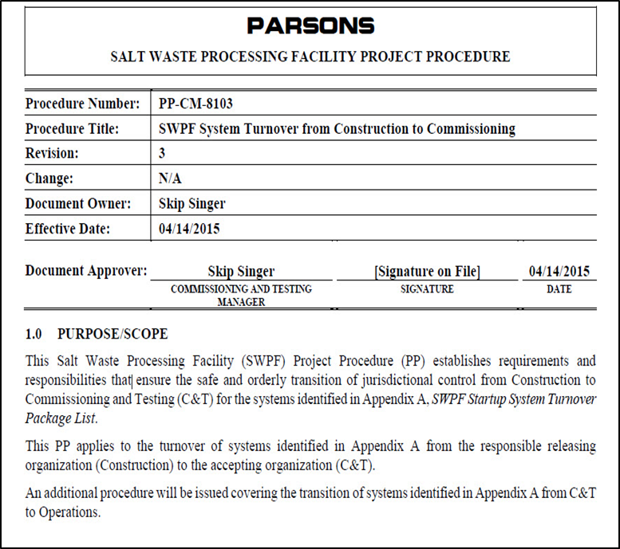
Parsons Turnover Process
Contract recognizes PP-CM-8103, “System Turnover from Construction to Commissioning” as establishing the requirements for system turnover.
Parsons System Turnover Process addresses:
Roles and Responsibilities
The Turnover Package
The Turnover Process
The Transfer of Jurisdictional Control from Construction to Commissioning and Testing
Guidance for a turn-back process used for construction work such as testing reveals a need for design change or latent defect.

Slide 10
Parsons Turnover Process
Prepare Turnover Package
Punchlist Item Categorization
Final Walkdown
(10 day notification required)
0
71 Systems Turned Over
Initial Walkdown
(10 day notification required)
Complete “A”
Punchlist Items
Jurisdictional Control is Transferred
Work Off “B” Punchlist Items
Manageable List at Construction Completion

Slide 11
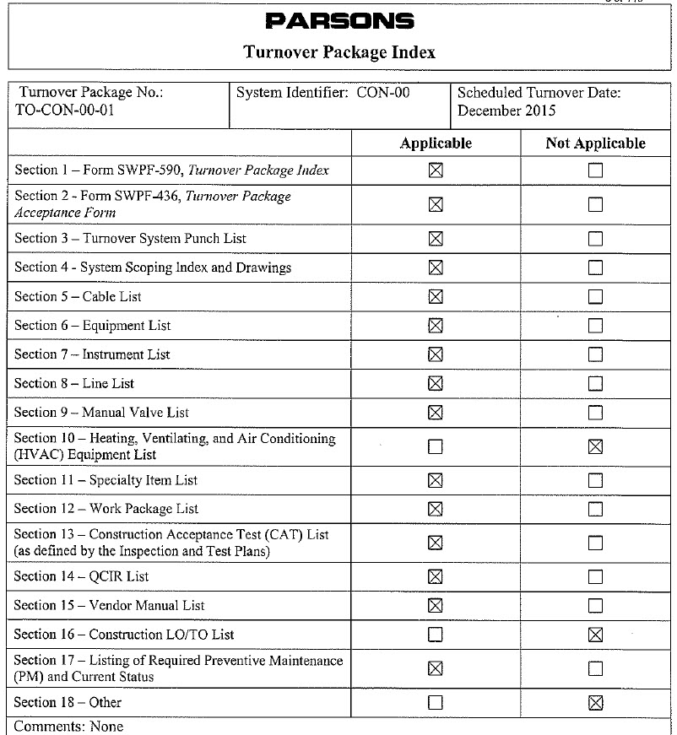
Parsons Turnover Process – Prepare Turnover Package
Preparation of a Turnover Package
Construction assembles the Turnover Package
18 sections in every Turnover Package
Applicable/Not Applicable sections are identified
Turnover Package draft sent out for review at initial walkdown
Quality Assurance (QA) reviews the package for completeness and accuracy
Turnover Package approved by Commissioning Manager after Final Walkdown

Slide 12
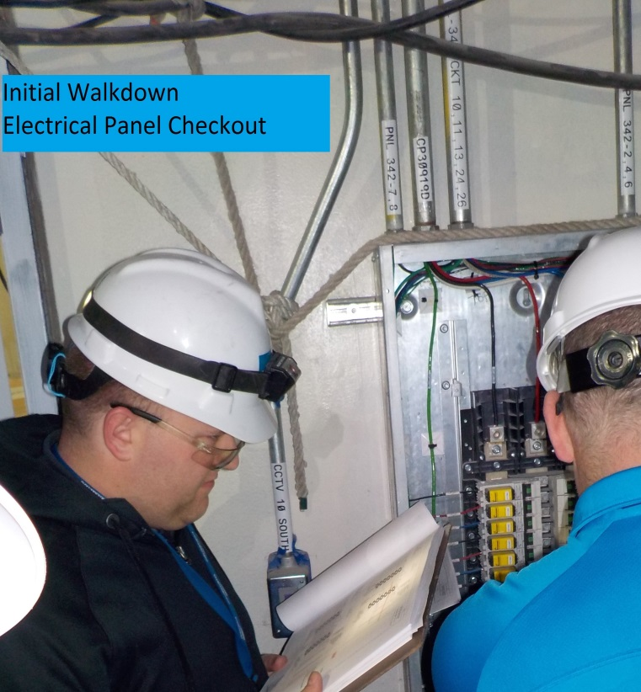
Parsons Turnover Process – Initial Walkdown
Construction, Cognizant System Engineer (CSE), and Commissioning and Testing (C&T) required for Initial Walkdown
Purpose of Initial Walkdown:
Determines system readiness for Turnover
Confirms System Turnover Boundaries
System Boundary Drawings are under configuration control
Master set of Boundary Drawings that ensures no gaps between systems
Identifies punchlist items
Quality Assurance (QA), Operations (OPS), Environment, Safety & Health (ESH), and DOE are notified
DOE attends all Initial Walkdowns
10 Day formal notification required
Weekly System Planning Meeting
Manages punchlist item closure
Walkdown scheduling
DOE attends
Identifies punchlist items
Initial Walkdown Electrical Panel Checkout

Slide 13
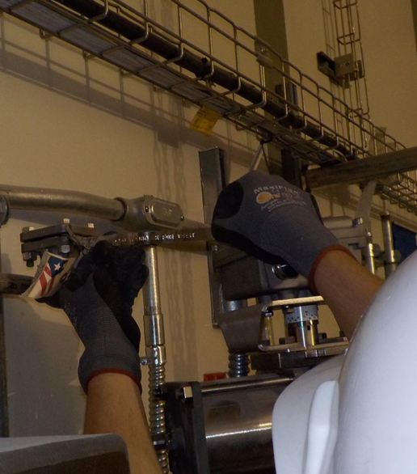
Parsons Turnover Process – Punchlist Item Categorization
Parsons Commissioning Manager is the single point of decision for Punchlist Categorization
Categorization of Punchlist items is based on Definitions in “System Turnover from Construction to Commissioning” procedure (PP-CM-8103)
“A” Punchlist Items are required to be complete prior to final system turnover walk-down
“A” punchlist items include: inoperable equipment required for component/system testing; other items necessary for safe completion of component/system testing, and component labeling necessary for system testing
Responsible organization works the “A” Punchlist Items to completion
Punchlist items are managed through a configuration controlled database
Parsons Commissioning & Testing validates the items and closes in the database
Turnover package updated with closure documentation
Construction Completion Criteria at SWPF incorporates lessons learned from other recent projects (IWTU and DUF6) in that SWPF “A” Punchlist Items must be completed prior to Construction Completion
Initial Walkdown revealed V8380 not restored from testing
(“A” Punchlist Item)

Slide 14
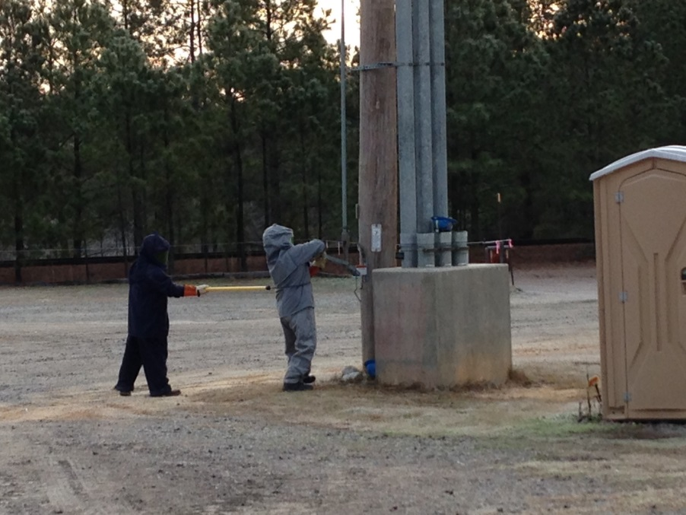
Parsons Turnover Process – Final Walkdown
Occurs upon completion of all “A” Punchlist Items
Construction, Commissioning & Testing (C&T), and Cognizant System Engineer (CSE) are required for Final Walkdown
Purpose of the Final Walkdown:
Validate completion of “A” Punchlist Items
Ensure no additional Punchlist Items
QA, Operations (OPS), Environment, Safety & Health (ESH), and DOE are notified
DOE attends all Final Walkdowns
10 Day formal notification required
Switch is Thrown To Energize SWPF

Slide 15
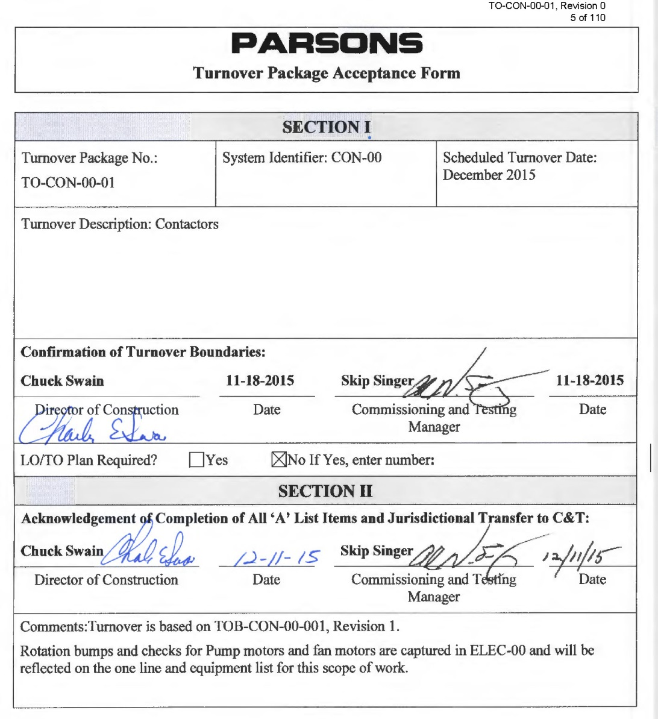
Parsons Turnover Process – Transfer of Jurisdictional Control
Director of Construction and Commissioning Manager signs Turnover Package Acceptance Form
After Initial Walk Down to confirm Turnover Boundaries (Section I)
After Final Walkdown to acknowledge completion of all “A” Punchlist Items and Jurisdictional Transfer (Section II)
OPS hangs jurisdictional tags after C&T assumes control of a system
Physical identification preventing further construction activity

Slide 16
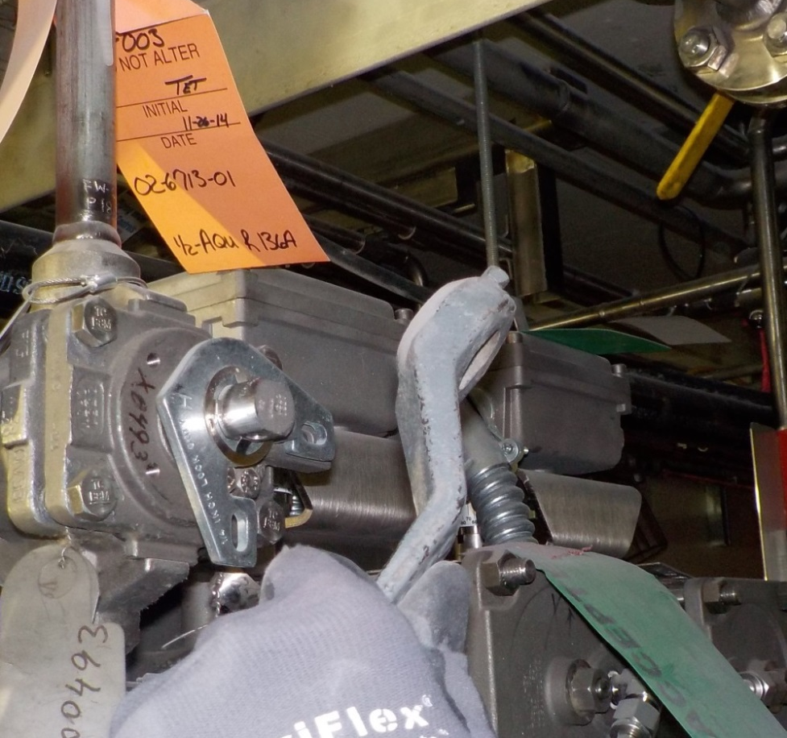
Parsons Turnover Process – Work Off “B” Punchlist Items
Type “B” Punchlist Items are maintained in the punchlist database
“Manageable List” of Type “B” Punchlist Items:
Resourced to complete within 6 months of construction complete
Documented and accepted as part of Declaration of Construction Completion
Demonstrated via a resource loaded schedule
Completed within the Over Target Baseline budget
Initial Walkdown “B” Item
Handle Not Tightened

Slide 17

DOE TURNOVER OVERSIGHT
AT SWPF

Slide 18
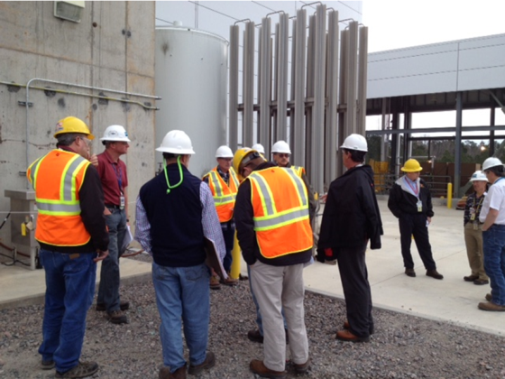
DOE Turnover Oversight - Objectives
Understand DOE’s turnover oversight process
Relationship to the SWPF Certification and Verification Plan (CVP)
How the process is structured
Components of the process
How the components work together
How the turnover oversight process ties to DOE’s concurrence with Parsons’ Declaration of Construction Completion
Walkdown of Lockout to extend Decontaminated Salt Solution Transfer Line

Slide 19
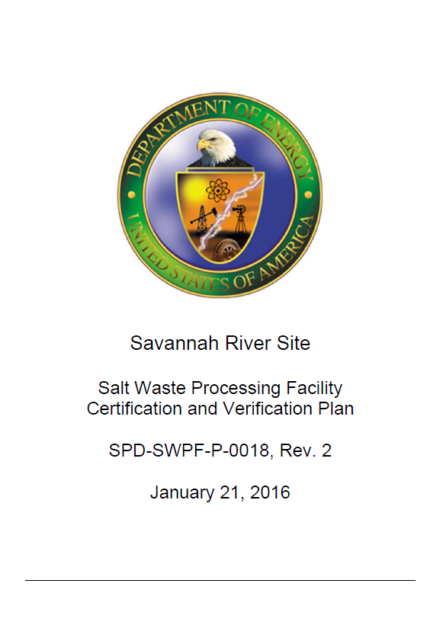
DOE Turnover Oversight - Relation to CVP
The CVP summarizes DOE Salt Waste Processing Facility Project Office (SWPFPO) Integrated Project Team (IPT) oversight activities leading to Critical Decision 4 (CD-4)
The CVP focuses on 4 Primary Areas:
Construction Complete (Turnover)
Component/System Testing
Operational Verification
Readiness Validation
Turnover Oversight Process is governed by SWPF-15-DI-001

Slide 20
DOE Turnover Oversight
Personnel
Turnover Package Review
Assessmen
t
Documentation:
Turnover Checklist
Turnover Affirmation
Walkdowns
Punchlist
SWPF Project Office Management
All 71 systems go through this process
Line Management Review Board (LMRB)

Slide 21
DOE Turnover Oversight – Personnel
Turnover Personnel assigned for EACH system
DOE IPT System Lead
Member of the SWPFPO IPT Construction and Startup (C&SU) Division
Serves as CVP’s Construction Turnover Specialist
DOE IPT System Engineering Lead
Member of SWPFPO ITP Engineering Division
DOE IPT C&SU Division
Member of the SWPFPO IPT C&SU Division
Turnover Personnel received training on the DOE oversight procedure
DOE SWPFPO has Subject Matter Experts (SMEs) with experience from other DOE projects (IWTU, DUF6, MOX, DWPF, ARP/MCU)

Slide 22
DOE Turnover Oversight – Personnel (cont.)
System Responsibility Matrix
The 71 systems were divided into 12 areas aligned with the Parsons’ CSE assignments
IPT assigned personnel based on subject area of expertise
The right people reviewing the right systems
Area | System Turnover ID | Title | DOE IPT Turnover System Lead |  | DOE Design Authority System Lead
 |  |  | Primary | Alternate | Primary | Alternate
Electrical | ELEC-00 | Electrical | Bryan | Albright | Tshishiku | Tshishiku
 | DG-00 | Standby Diesel Generator
 | UPS-00 | Uninterruptable Power Supply
 | PMS-00 | Power Monitoring System
BPCS/SIS | ICP-00 | Instrument Control Panels | Bryan | Albright | Vanpeursem | Hewitt
 | BPCS-00 | Basic Process Control System |  |  | Hewitt | Vanpeursem
 | SIS-00 | Safety Instrumented System
 | RPS-00 | Radiation Monitoring |  |  |  | Tshishiku
 | CTV-00 | CCTV
Plant Air/Gas/Dilution | AIR-00 | Plant Air | Bryan | Mayo | Zalants | Ridley
 | AIR-01 | Plant Air – AFF Segments
 | ADS-00 | Air Dilution
Material Handling | MHD-00 | Material Handling Equipment | Bryan | Albright | Zalants | Tshishiku

Slide 23
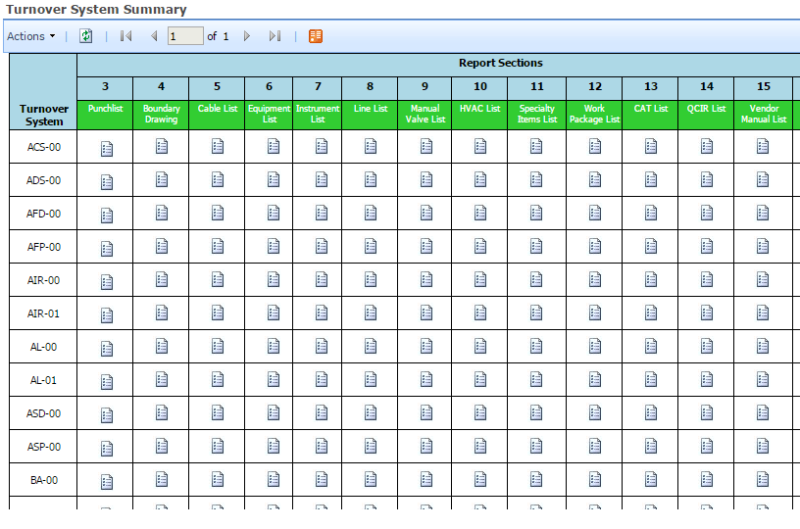
DOE Turnover Oversight - Turnover Package Review
DOE reviews all turnover packages
Turnover Package review starts prior to initial walk down.
Turnover Package review is completed after the final walk down.
Data is readily available for review via the Parsons Turnover System Summary Database
Within a few clicks the reviewer has access to actual scanned work documents
This system should be a best practice in the lessons learned report
The database consists of 12 different databases linked together which allows the system to provide current data

Slide 24
DOE Turnover Oversight – Turnover Package Review (cont.)
Turnover Package Reviewers
Turnover System Lead (SL)
Sections 1-4, 15-18 which cover Administrative sections, system boundaries, maintenance sections, and other
The SL also combines other reviewers’ inputs and prepares and presents the assessment
Engineering (ENG)
Sections 5-11 –commodities (valve list, line list, specialty items, equipment and cables)
Includes design and installation of the system to ensure they are consistent with the system description in the Preliminary Documented Safety Analysis (PDSA)
Construction and Start Up (C&SU)
Sections 12-14 work packages/quality records
Documentation of field work complete as well as applicable Construction Acceptance Testing

Slide 25
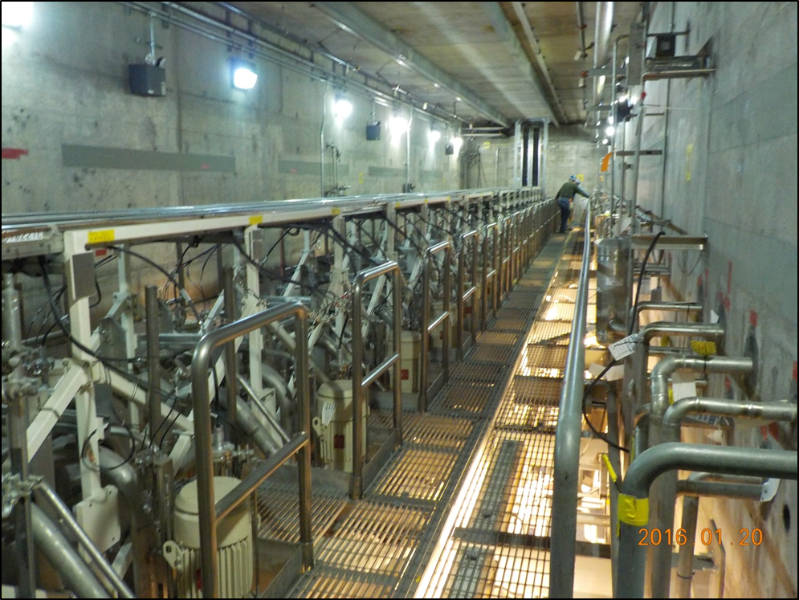
DOE Turnover Oversight – Walkdowns/Punchlist
Initial and Final Walkdowns
DOE participates in ALL Initial and Final System Walkdowns
System Lead participates in and document the formal walkdowns
QA participates as requested
Process Improvements since implementation
Improved formality for conduct of walkdowns
Partnering walkdowns between DOE oversight and Commissioning and Testing Group prior to Initial and/or Final Walkdowns
DOE oversees validation of Type “A” Punchlist Items as they are completed
Contactors turned over December 11, 2015

Slide 26
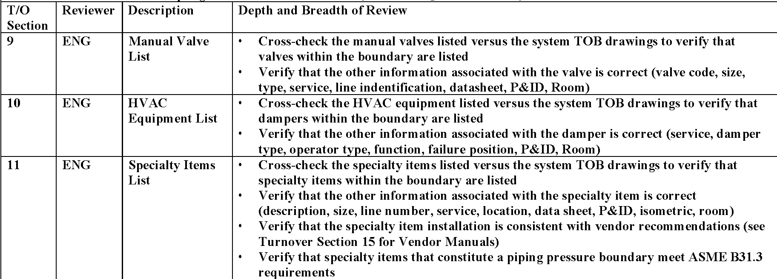
DOE Turnover Oversight – Documentation
Turnover Checklist:
SWPF-15-DI-001, Attachment 1, DOE Turnover Oversight Guidance, identifies criteria for review of each turnover activity/package section
Reviews are conducted on a sampling basis
Sample size takes into account Safety Significant (SS) Items, Mission Critical Nature of the System, and Hazards and Risks

Slide 27

DOE Turnover Oversight – Documentation (cont.)
Checklist
Captures all activities performed by all reviewers
Includes all document reviews
Includes observations of the Contractor’s walkdowns, reviews, and other turnover activities
Includes identified issues and resolution
Managed and maintained by the System Lead
All reviewers provide input to the Checklist

Slide 28
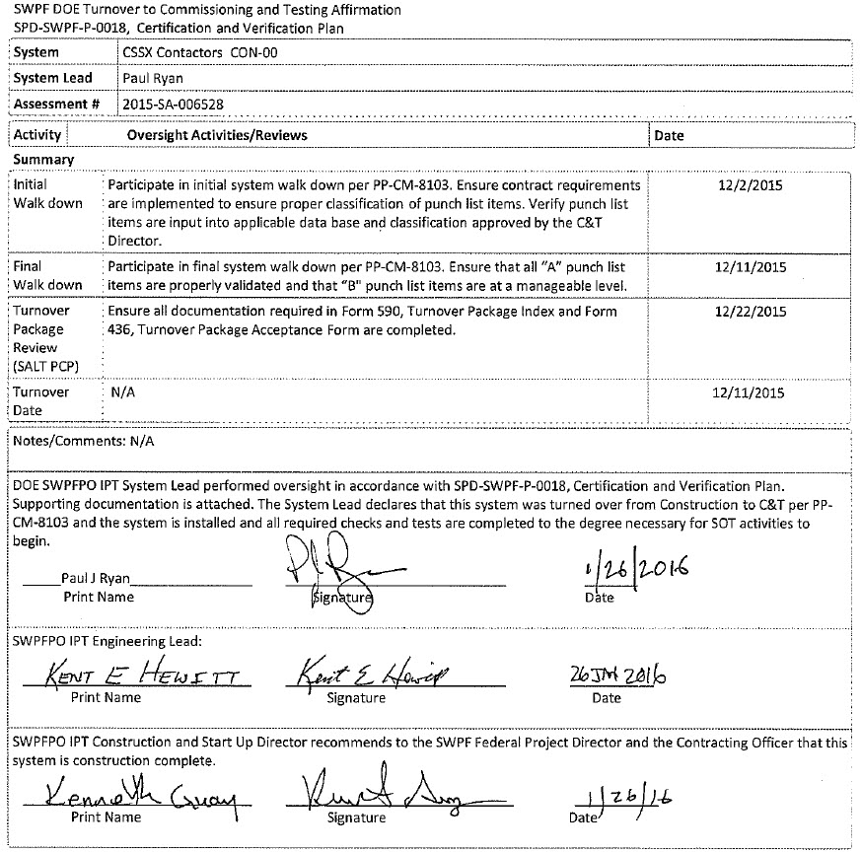
DOE Turnover Oversight – Documentation (cont.)
Turnover Affirmation:
Provides declaration of Initial and Final Walkdown participation
Provides declaration that the turnover package review was completed
Signed by System Lead (SL) and System Engineering Lead (ENG)
Is the recommendation of DOE Commissioning & Start-up (C&SU) Director to Federal Project Director and Contracting Officer that the system is Construction Complete

Slide 29
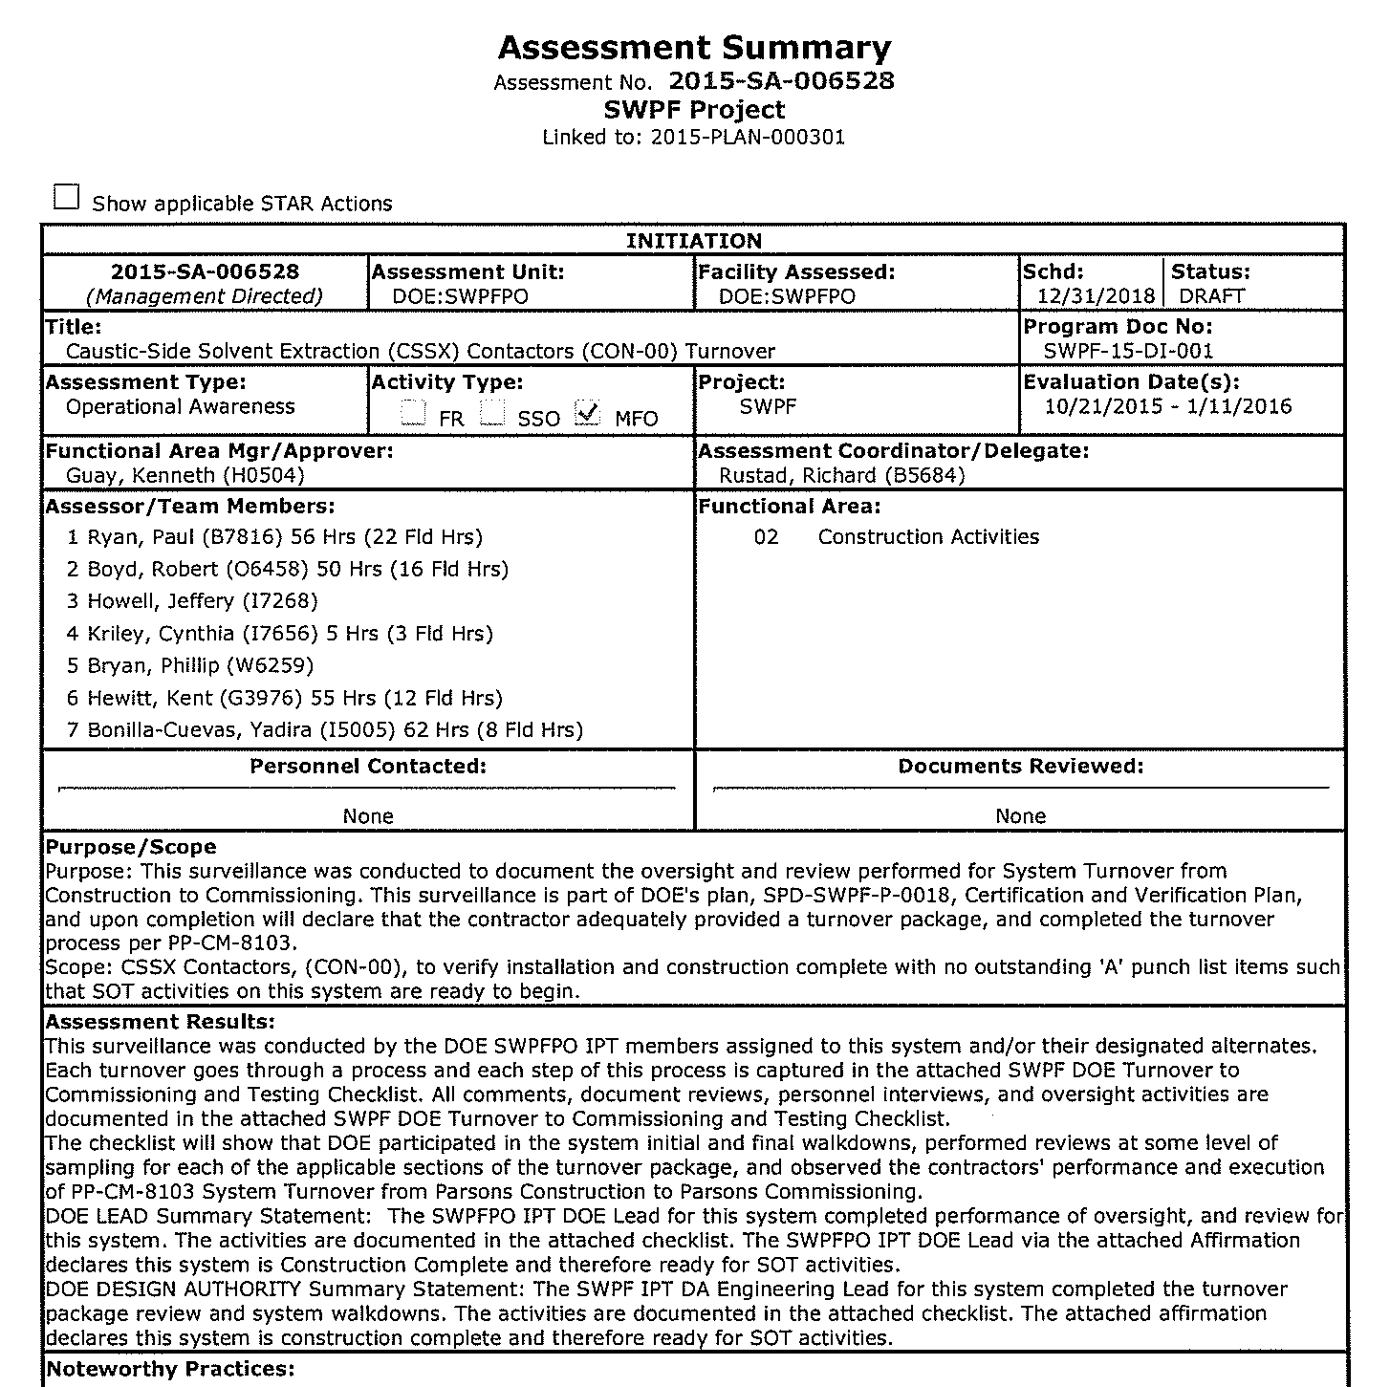
DOE Turnover Oversight – Assessment
Summarizes the system turnover review efforts
Provides a records repository for the Checklist and Affirmation
Documents any findings identified during system turnover oversight and review
Is presented to the Line Management Review Board (LMRB)

Slide 30
DOE Turnover Oversight - Line Management Review Board (LMRB)
Provides a forum for DOE management review of selected readiness documents to ensure that integrated readiness oversight activities adequately assess the overall achievement of operational readiness
The LMRB was established early to utilize the senior management oversight concept for turnover
Key Members
SWPF Federal Project Director (LMRB Chair)
SRS Deputy Site Manager (Executive Advisor)
DOE-SR Chief Engineer
Assistant Manager for Waste Disposition
Assistant Manager for Nuclear Materials Stabilization
Assistant Manager for Infrastructure and Environmental Stewardship
Director for Office of Safety and Quality Assurance
SWPF DOE Headquarters Liaison
Ad Hoc Appointees as needed

Slide 31
DOE Turnover Oversight – Other Activities
Verification of Disposition of all Engineering Open Items
The DOE FPD has directed Parsons to resolve all DOE identified findings to DOE’s satisfaction prior to declaring Construction Completion.
Oversight of Permanent Power Electrical Energization
Conducted Vendor/Supplier source oversight and on-site inspections of sampled Structures, Systems, and Components (SSC) installation. Deficiencies have been identified in hardware and documentation for Parsons’ resolution.
Verified pedigrees of ASME Large Vessels, Caustic-Side Solvent Extraction (CSSX) contactors and skids, including factory testing
Verified Quality Data Packages & Work Packages for High Level Waste Transfer Lines
Reviewed ~95% of all weld radiographs of ASME Piping Systems taken since 2013, and is reviewing a sample of Dark Cell weld radiographs from years 2009 – 2012
Resolved electrical inspection issues (bend radius)

Slide 32

Readiness to Test

Slide 33
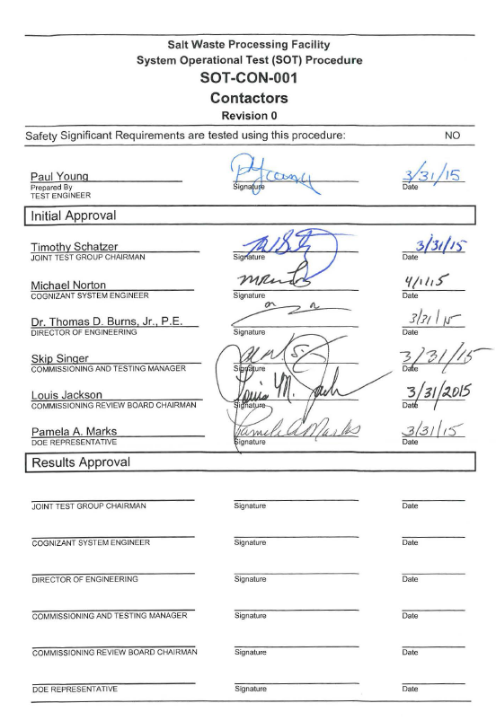
Readiness to Test – Initial Testing
SOT/ISOT Approval
Test procedures are reviewed by Contractor and DOE concurrently
Review comments are dispositioned through the Joint Test Group (JTG).
Test procedures are sent to Commissioning Review Board (CRB) for approval.
FPD is a voting member of the CRB
There are 60 SOTs and 5 ISOTs
Approval of all test procedures is a condition of Declaration of Construction Completion

Slide 34
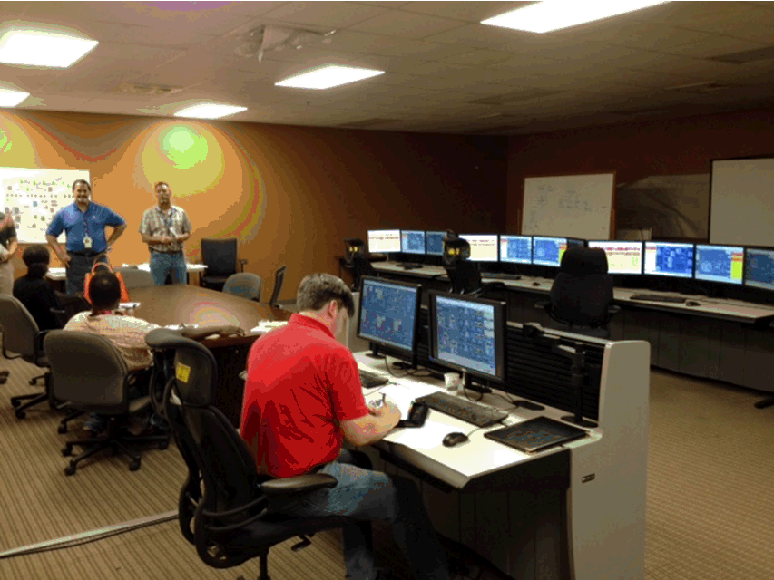
Readiness to Test – Parsons’ Personnel Staffing to Support Testing
Staffing of Commissioning and Test personnel on track to support the commencement of testing in late April/May (25 of 31 positions filled to date).
Operations staffing in place to provide support of the Testing program (54 of 54 filled).
Maintenance staffing in place to support testing. Additional hiring is anticipated to provide future maintenance needs. (28 hired to support testing).
Parsons recently hired 2 senior managers with extensive readiness and commissioning experience (Bob Traynor and Jerry Long)
Parsons recently added experienced Readiness and Startup Leadership for support of the MSA-1, Transition to Testing (Bob Parks)
Control Room Simulator Training at Parsons’ Technology Center

Slide 35
Readiness to Test – Parsons’ Management Self-Assessment-1
This MSA is the first in a series of MSAs to be performed in the project path to Critical Decision 4 (CD-4)(Approve Start of Operations or “Project Completion”)
MSA-1 will evaluate the Project’s readiness to conduct the System Testing program.
The focus of MSA-1 will serve as the basis for the Project Manager’s Approval to Commence Testing.
The performance objectives and assessment criteria are limited to those necessary for System Testing and related Work Control.
MSA-1 was initiated February 8, 2016 and will conclude on April 1, 2016
DOE is conducting oversight of MSA-1

Slide 36
Pathway to Readiness Success
Integrated Baseline Review (IBR) ensured realistic and achievable baseline to achieve CD-4
First of a Kind review in DOE
Chemical Simulants to be used during Cold Commissioning
ARP/MCU and Parsons' Technology Center testing to continue until SWPF start-up
Hired DOE Readiness Review Coordinator early in the Project (4 years prior to scheduled CD-4)
Developing a Plan of Action (POA) early in the Project (18 months ahead of schedule)
Incorporated Lessons Learned from other projects
Shared readiness expectations and lessons learned early with Contractor
POA Scoping meetings conducted with Contractor
Implemented oversight CVP during construction phase of the Project
Developed 8-hour CVP Training course for Integrated Project Team members
Contractor participated in CVP Training
Implemented resource-loaded project schedule of DOE Readiness activities which is tied to the Contractor Project schedule
Cognizant System Engineers in place and provisionally qualified

Slide 37
Pathway to Readiness Success (cont.)
Initiated LMRB early in the Project
Independent Board comprised of senior DOE managers responsible for reviewing various readiness deliverables (e.g., Turnover Packages, Readiness Affirmations, Program Documents for DOE approval, etc.)
SWPFPFO personnel regularly attend Contractor Planning, Scheduling, and Project Status meetings
Establish a continuous presence in the field
Focus on working closely with Contractor to resolve issues as they are identified
Contractor to perform 3 MSAs
Readiness to Test (MSA-1);
Ready for Cold Commissioning (MSA-2);
Ready to proceed into the Contractor Operational Readiness Review (CORR) (MSA-3)
DOE provides oversight for all MSAs
DOE will conduct independent Integrated Safety Management System (ISMS) Assessments. Final verification of ISMS implementation will be part of Operational Readiness Reviews.

Slide 38
Acronym List
AFF Alpha Finishing Facility
ARP Actinide Removal Process
ASME American Society of Mechanical Engineers
C&SU Construction & Start Up
C&T Commissioning & Testing
CCA Cold Chemical Area
CD-4 Critical Decision-4
CG&A Calibration, Grooming & Alignment
CO Contracting Officer
CORR Contractor’s Operational Readiness Review
CPA Central Processing Area
CRB Commissioning Review Board
CSE Cognizant System Engineer
CSSX Caustic Side Solvent Extraction
C&SU Construction & Start-up
CVP Certification and Verification Plan
DOE Department of Energy
DUF6 Depleted Uranium Hexafluoride
DWPF Defense Waste Processing Facility
ENG Engineering
ES&H Environment, Safety and Health
FPD Federal Project Director
IPT Integrated Project Team
ISMS Integrated Safety Management System
ISOT Integrated System Operability Test
IWTU Integrated Waste Treatment Unit
JTG Joint Test Group
LMRB Line Management Review Board
MCU Modular Caustic-Side Solvent Extraction Unit
MOX Mixed Oxide Facility
MSA Management Self Assessment
OPS Operations
OTB Over-Target Baseline
POA Plan of Action
PP-CM Project Procedure Commissioning
QA Quality Assurance
SL System Lead
SME Subject Matter Expert
SOT System Operability Test
SS Safety Significant
SSC Safety Significant Components
SWPF Salt Waste Processing Facility
SWPFPO Salt Waste Processing Facility Project Office
WTL Waste Transfer Line

Slide 39
Back up / supporting slides

Slide 40
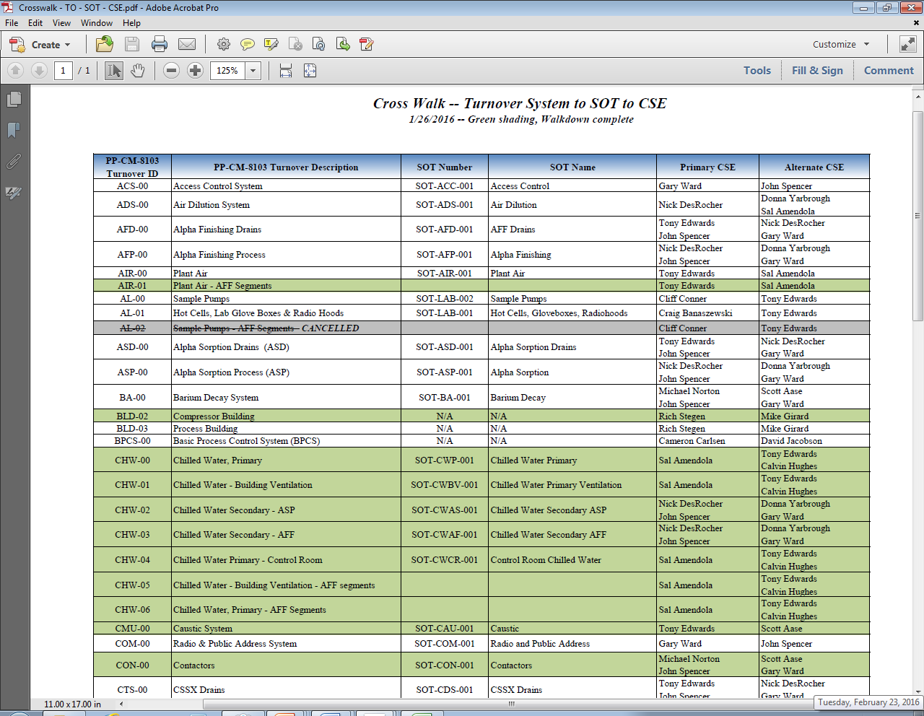
List of 71 Systems - Crosswalk – Turnover System to SOT to CSE 1/26/2016 – Green shading, Walkdown Complete

Slide 41
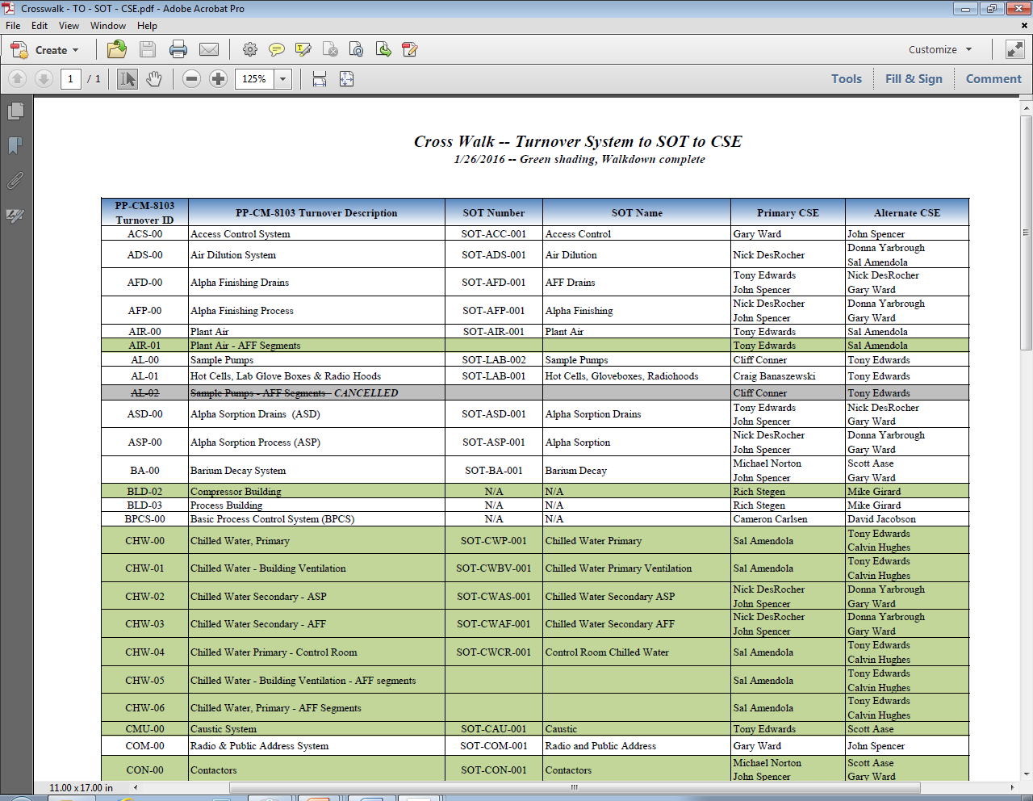
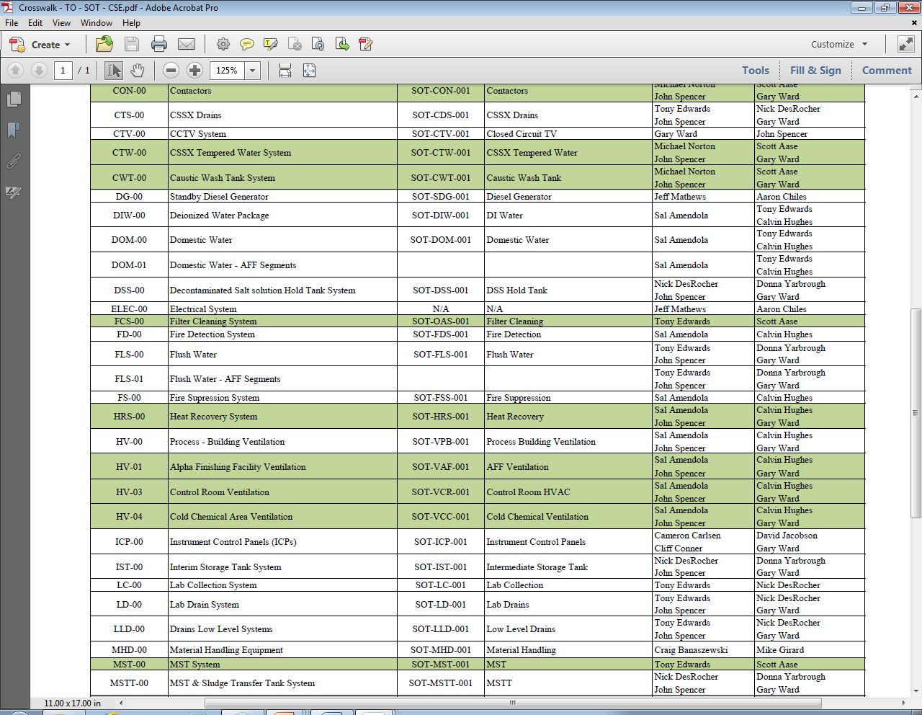
List of 71 Systems (cont.)

Slide 42
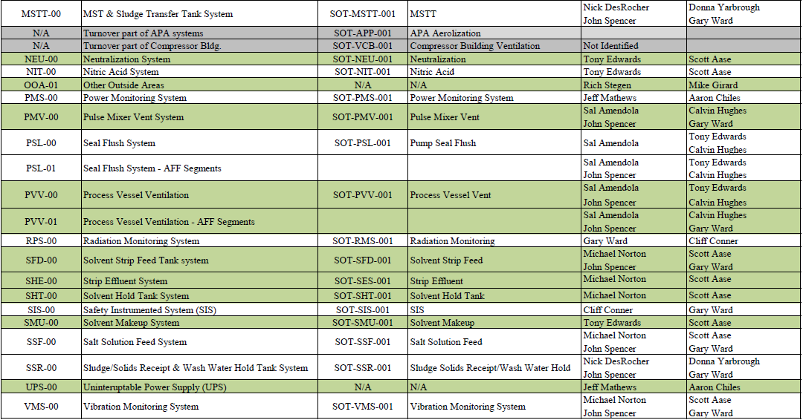
List of 71 Systems (cont.)

Slide 43
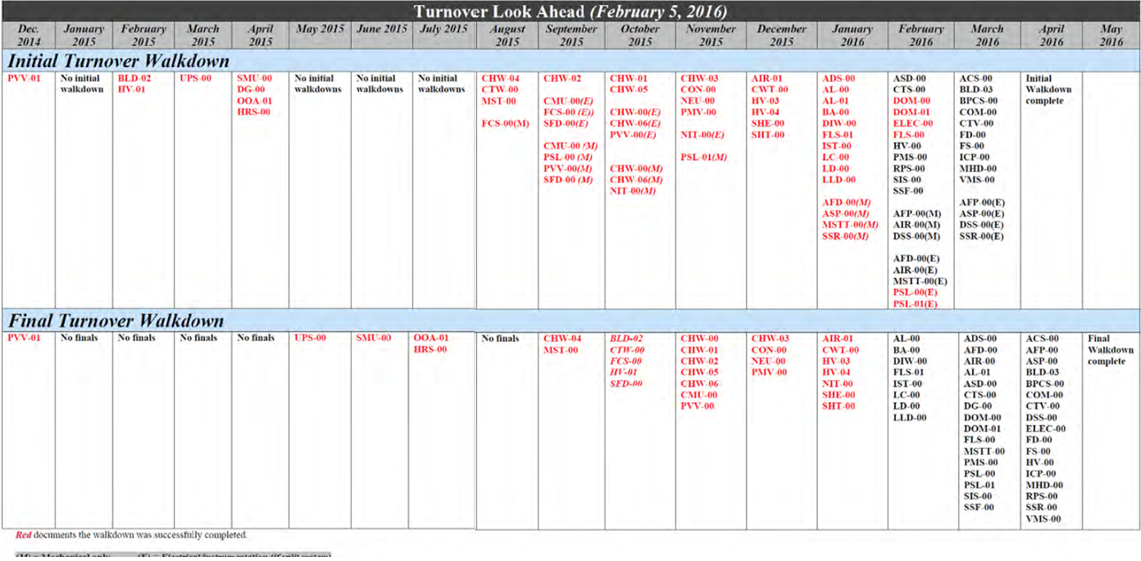
SWPF Current Status of System Turnover
Use Chart from Monthly to HQ
Accepted by DOE thru 2/24/16

Slide 44
Readiness to Test - MSA-1 Team
MSA-1 Team Members | Assigned Area | DOE Oversight
Bob Parks | Team Leader | Mac Hogle
Bob Traynor | Testing, Plant Staffing | Jeff Howell (TE, PS)
Brad Swanson | Work Planning and Control, Maintenance Implementation | Rodney Walker (WP, MI)
Leah Lavalle | Emergency Management, Conduct of Operations, Procedure Development and Verification | Duane Delmore (EM) Irvin Rubin (CO and PD)
Jerry Long | Quality Assurance, Software Quality Assurance, Cyber Security | Herman Kunis (QA) Jacob Miller (SQ) Marcus Saint Jean (CY)
Tom Helms | Training and Qualification, Integrated Safety Management System, Environmental | Roger Battles (TQ) Scotti Fryar (ISMS) Armanda Watson (Envr.)
Bill Brasel | Fire Protection, Engineering, Configuration Management | James Harris (FP) Richard Rustad (EN, CM)
Mike Pittman | Occupational Safety and Health Chemical Safety | Gina Price (SH, CS)

